Slide 1
Javascript Dashboard Elements – Part 2
Dr Simon Lock
simon.lock@bristol.ac.uk

Slide 2
Overview
Today we will continue working with Javascript
Focusing on graphing/charting dashboard widgets
A common element of many projects…
Graphically show the user some numerical data

Slide 3
Approach
Various libraries are available
We’ll consider one in particular (chart.js)
Before we do that, it is useful to see how they work
Sometimes library won’t do exactly what you want
In which case you’ll have to “go low-level”
And build your own widget from scratch !

Slide 4
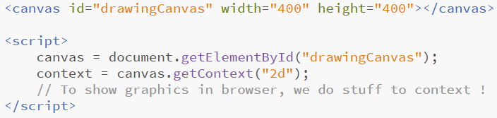
HTML5 Canvas
A new page element introduced in HTML5
A “blank slate” element - a raw painting canvas
Add one to your page like so:

Slide 5
Scripting a canvas
We then write Javascript to draw onto that canvas
Before we draw, we must get hold of the canvas
(using the good old “getElementByID”)
And then we must get a drawing “context” from it
A bit like a drawing layer on top of the canvas
There are different types of context (2D, 3D etc)
In this session we are only interested in 2D…

Slide 6
But what can we draw ?
Lines
Rectangles
Circles
Arcs (segment of a circle)
Bezier curves
Images (PNG, JPG, SVG)
Different colours, different outlines, different fills
Let’s look at some examples…

Slide 7
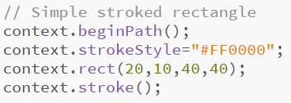
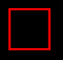
Outline (“stroked”) red rectangle

Slide 8
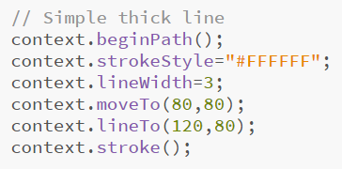
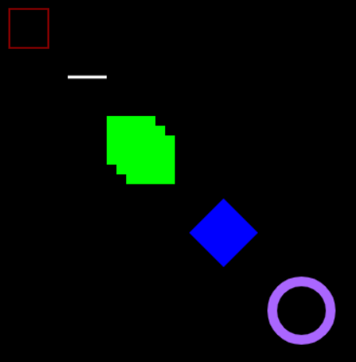
Thick white line

Slide 9
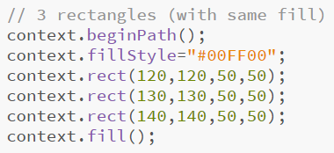
Composite of three green rectangles

Slide 10
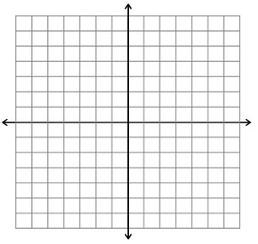
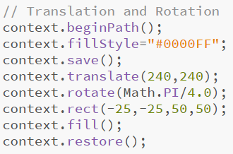
Translation and Rotation

Slide 11
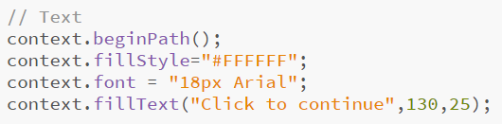

Rendering Text

Slide 12
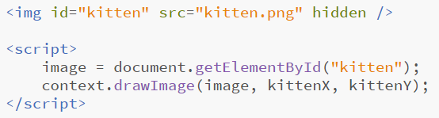
Drawing images
Image drawing is a little bit tricky…
Make sure image has loaded before drawing it !
Often involves putting code in “onload” functions

Slide 13
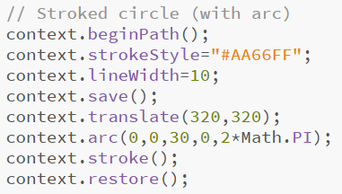
Thick Stroked Circle (using an arc)
Centre X
Centre Y
Radius
Start angle
End Angle

Slide 14
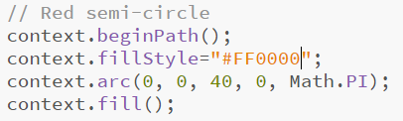

Red filled semi-circle

Slide 15
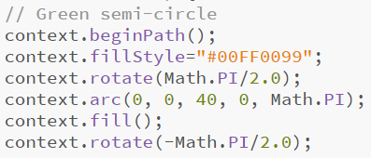
Semi-transparent green semi-circle
DEMO

Slide 16
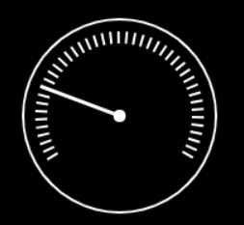
Bringing it all together…

Slide 17
Chart.js
Many graph/charting libraries are available
They provide good-looking graphs for little effort
We are going to use chart.js
It’s a typical example of the “breed”
Probably includes everything you’ll need !
Warning: My examples use version 2.7
Other versions can work very differently !!!!

Slide 18
Benefits of Chart.js
Easy to use, with only a little coding
Aesthetically pleasing
Well tested and robust
Fancy animations !
Wide range of graphs and charts supported…

Slide 19
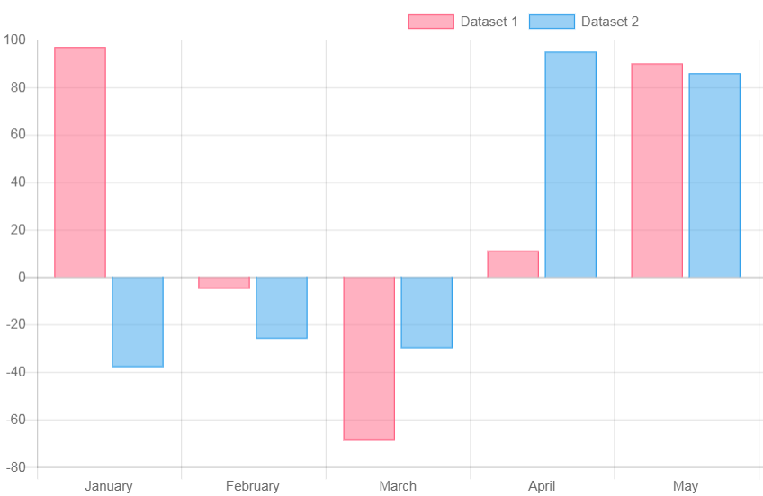
Bar Chart

Slide 20
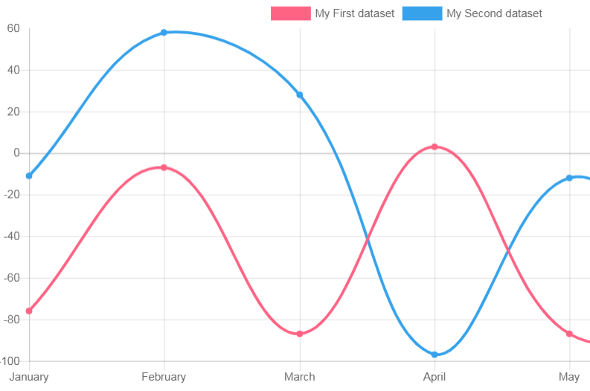
Line Graph

Slide 21
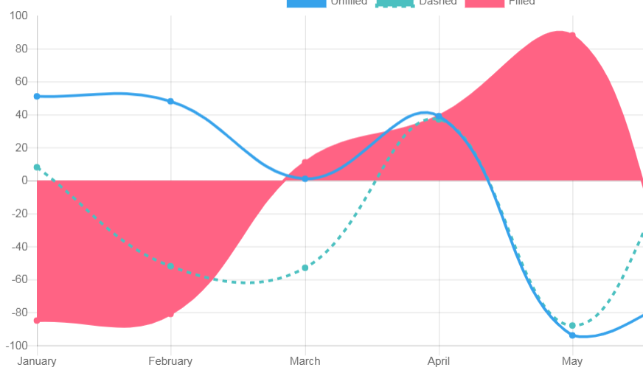
Different styles of Line Graph

Slide 22
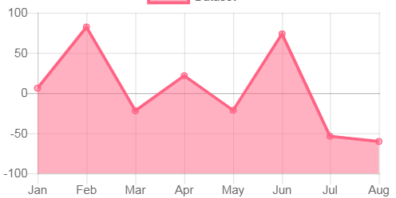
“Pointy” Line Graph

Slide 23
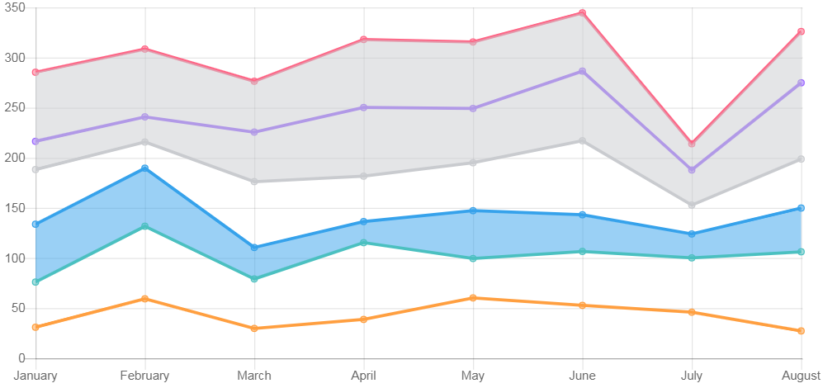
Stacked Line Graph

Slide 24
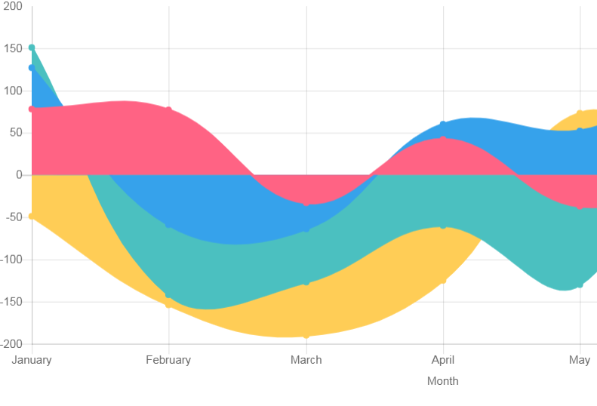
Overlaid filled Line Graph

Slide 25
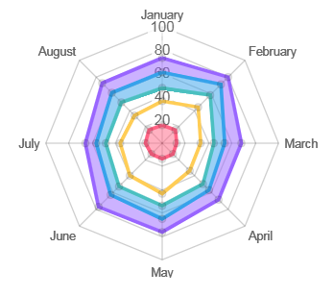
Radar Chart

Slide 26
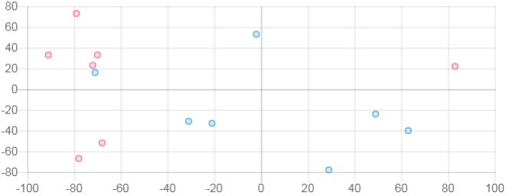
Scatter Plot

Slide 27
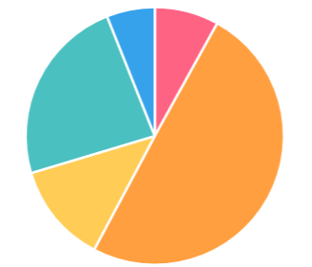
Pie Chart

Slide 28
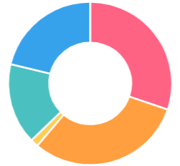
Donut Chart

Slide 29
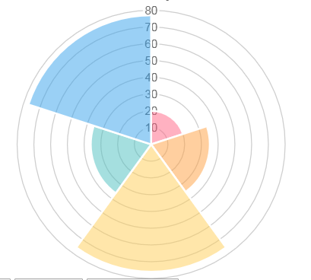
Polar Plot

Slide 30
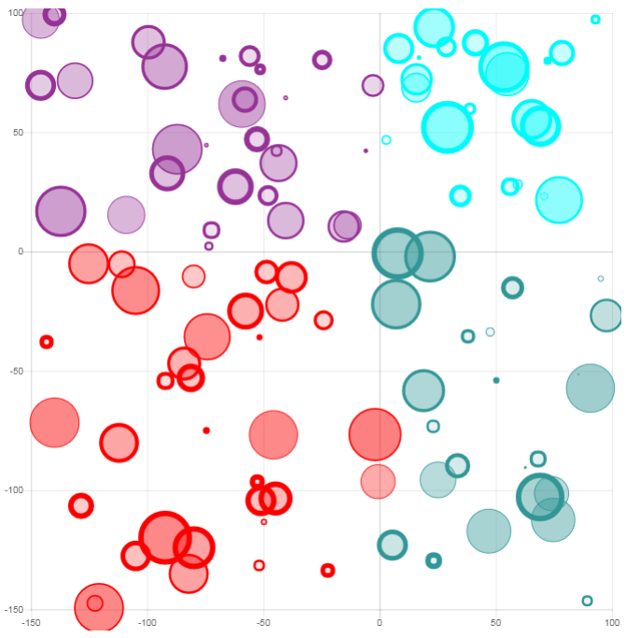
Bubble Chart

Slide 31
Using Chart.js
OK, you convinced me – chart.js is good
But how do you go about using it ?
It’s pretty simple, all you need is:
The chart.js library (a single file)
Some data to represent
A choice of graph to use
A choice of styles and colour
Then it’s just a case of putting it all together…

Slide 32
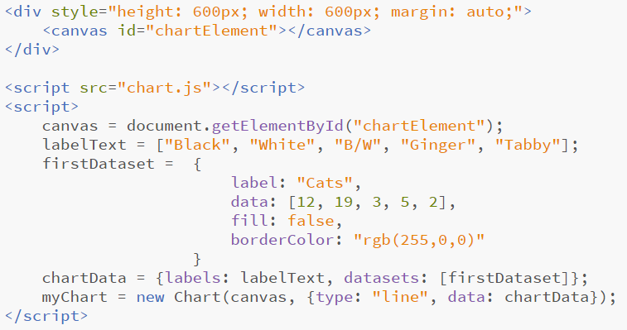

Slide 33
Chart
Chart Data
Dataset
Numerical Data

Slide 34
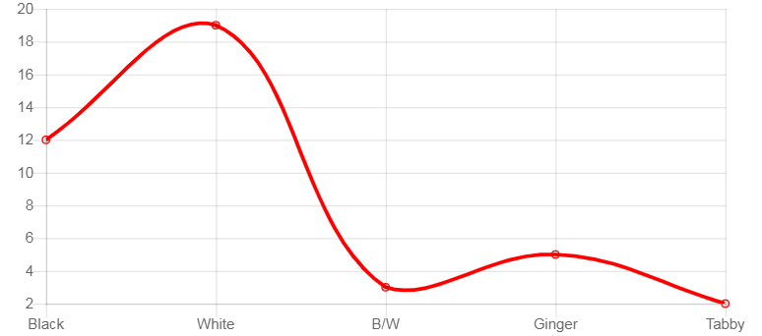
Looks like this…
Live Demo

Slide 35
There we go
We’ve covered a range of dashboard elements
Google Maps, Street View, Chart.js, Canvas
Some of most common elements for SPE projects
We’ve introduce and illustrated them in use
There should be no excuse for shoddy web pages !

